Slide 1
Best Movie Option Project
Ahmet Karaoglan
December 28,2021

Slide 2
Overview
I have been tasked with examining recent film data in order to come up with actionable recommendations for microsoft's entry into film making
They decided to consider the data
I will focus on film director genres and revenue areas.

Slide 3
Areas of Focus
GENRE
DIRECTORS
REVENUES
The most watched genre will be determined by considering the data.
Identify the directors of the best rated movies
As in every project, the best revenue will be determined.

Slide 4
Genre Analysis
best 5 genre to be observed
Conclusions
the company should focus on those gender
Drama
Action
Adventure
Crime
Sci-fi

Slide 5
Genre Analysis
Findings:
Most preferred genre identified
Conclusions:
The density of genre provides us with a target
Should the most preferred genre be our goals?
The right director, the right genre will carry us to high revenues

Slide 6
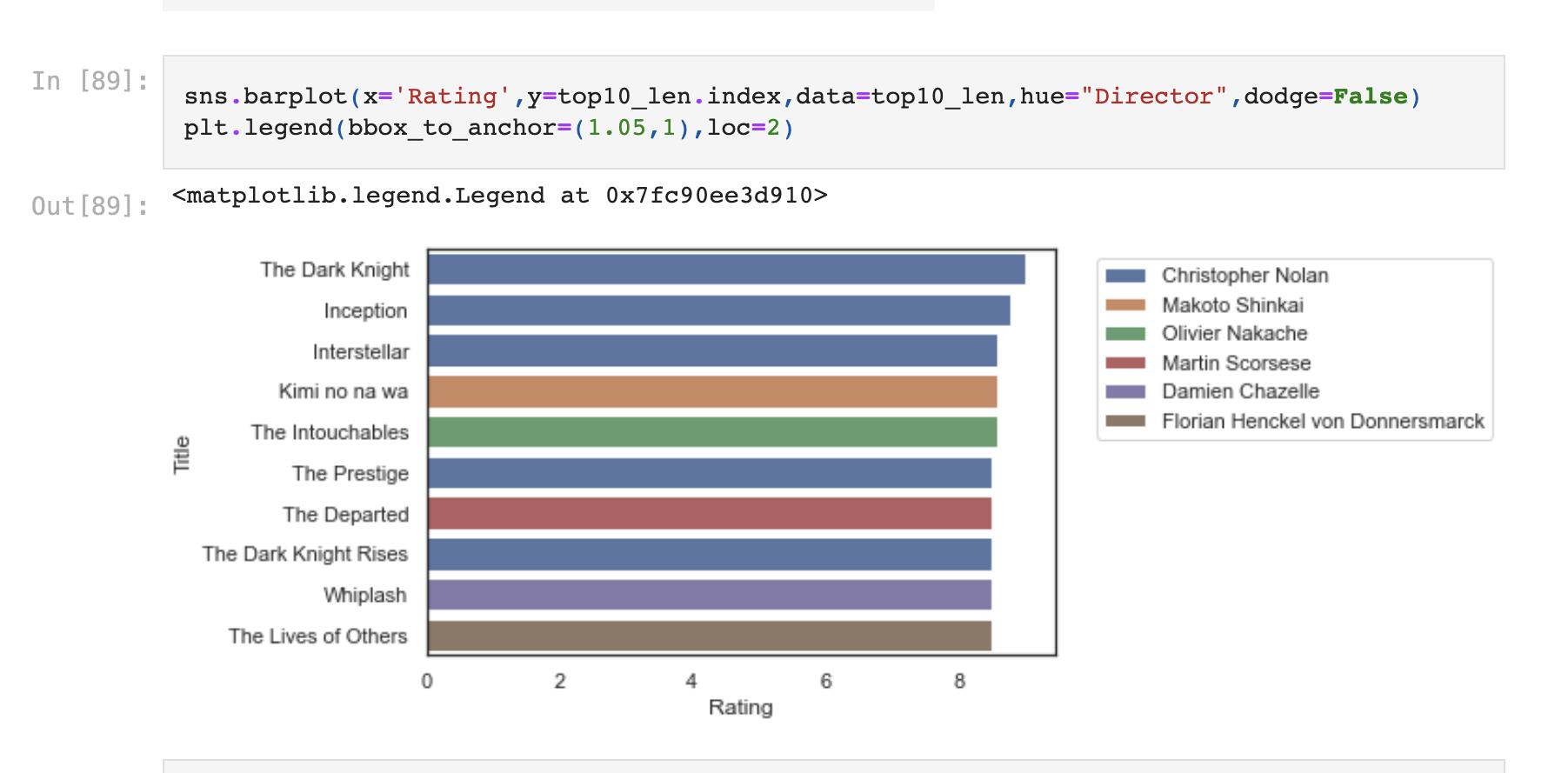
Top Directors
I examined data from imdb, in top 10
As you see Christopher Nolan at higher ranks

Slide 7
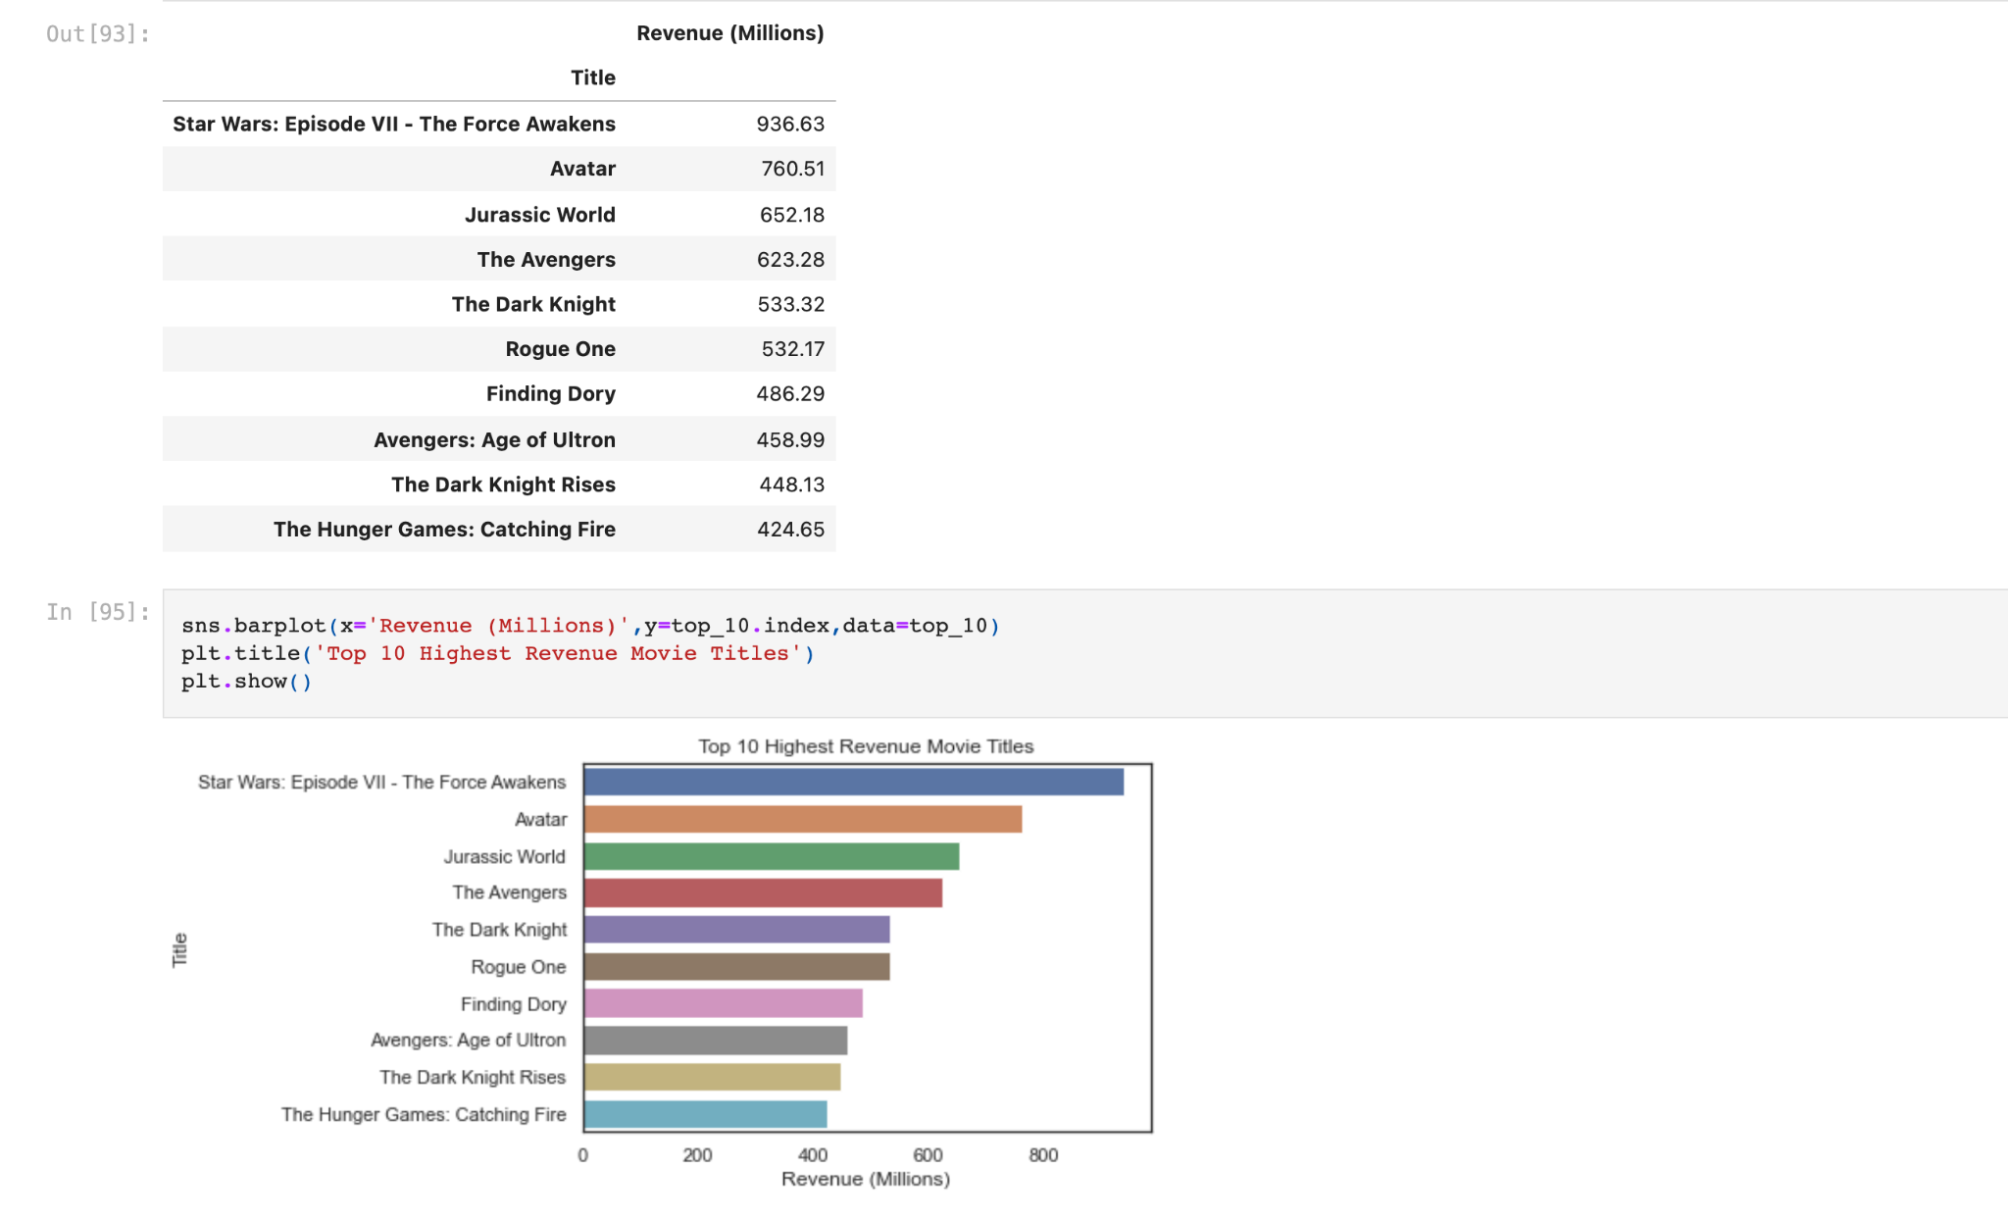
REVENUES
Finding:
The genres of top-grossing movies appear to be sci-fi and action
Conclusion :
Our aim should not be to determine only the best grosses and choose a movie of that type, addressing the general public will enable us to move forward more confidently.

Slide 8
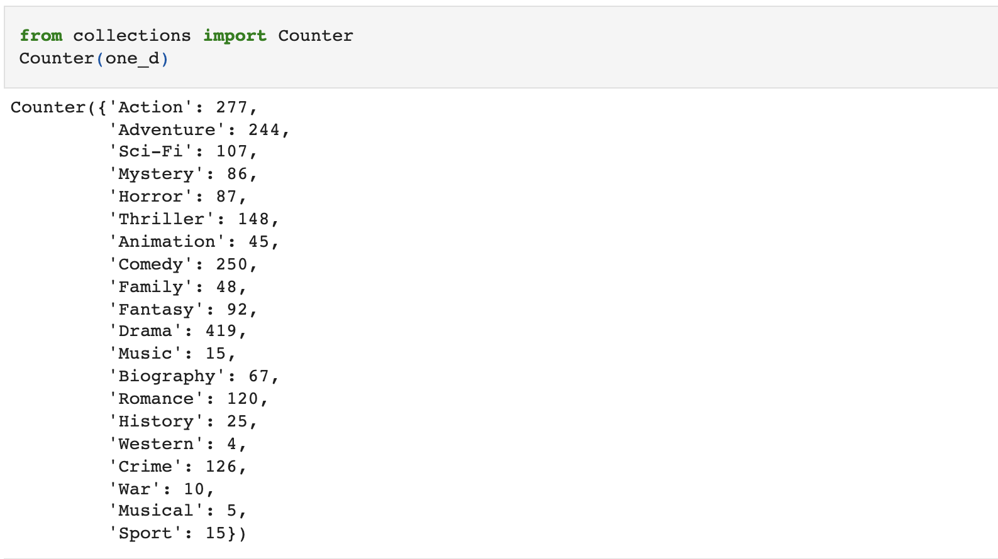
most popular movies
Drama 419
Action 277
Adventure 244
Crime 126
Sci-Fi 107

Slide 9
General Conclusion
The films with the highest rankings were determined.
best directors determined
imdb,rotten tomatoes,tmdb data were analyzed and it was determined that the most preferred movies were drama
Not seeing drama among the top-grossing doesn't mean a failed genre

Slide 10

Unhappy Faces are the Harbinger of Happy Days

Slide 11
Conclusion
using the data, it was determined that the most interacted genre was drama
It will be a better study for our company if we prefer this tour because of the low cost of shooting and the possibility of winning an award in the international film field.

Slide 12
Thank You !
Please feel free to ask any questions now
You may also reach me via email:
Ahmet Karaoglan
karaoglanahmet@hotmail.com

